Slide 1

NEW STORAGE WORLDWIDE
8901 sw 157 ave Uni 16-208
Miami FL 33197
Tel 786 658 0849
Email: storageworldwide@gmail.com

Slide 2
WHAT WE DO:
Structural Steel and Cold Form
framing
Mezzanines
Repairs
Hwy System
Exterior Units
Boat & RV Buildings
Display areas / Dummy doors
Wind load RUD Commercial RU Doors
Sky Lockers
Lockers / Sky lockers / Wine Lockers
Replacement Doors
MASS ( portable units)
Email: storageworldwide@gmail.com

Slide 3
ABOUT US
Our company is based on the installation of structural steel ,roll up doors, components for self storage, swing doors , interior hallway systems and replacement of Roll up doors and Mobile Units. Our specializations in mezzanines are most recognized. Our entire focus has been on making sure that our company is on its way to be the best it can be.
New Storage Worldwide has had the opportunity to work alongside companies like Janus, U-Haul, Waikato and many more. We work all around the nation. We have projects near North Carolina, Texas, FL, and Georgia etc, and with our bases in GA, SC and specially here in Florida .
Today I am contacting you because we are interested to start working as installers for you. I hope to hear back from you as soon as possible.
You can contact me, Wilson Vargas telephonically at cell: (786) 6580849 or by email storageworldwide@gmail.com
Thank you for the opportunity!
If you decide to partner with us, you won’t regret it.
Email: storageworldwide@gmail.com

Slide 4
RECENT PROJECTS
CUBE SMART
1710 ROUTE 22 S
UNION CITY- NJ 07083
(MULTY STORAGE )
SELF STORAGE
2308 HEINZ ROUTE
IOWA CITY- IA 52240
(MULTY STORAGE )
4019 AUGUSTA BLV
GARDEN CITY – GA 31408
(MOBILE HOMES -SWAP DOORS)
LIFE STORAGE
1600 WOODSON RD
OVERLAND –MO 63114
(MULTY STORAGE)
LIFE LOCK STORAGE
11100 LINPAGE PLACE
ST. LOUIS-MO
(MULTY STORAGE)
RIGHT MOVE STORAGE
7903 SOUTH LOOP EAST
HOUSTON –TX 77012
(MEZZANINE)
IOWA CLIMATE CONTROL
1720S FEDERAL AVE
MASON CITY- IOWA 50401
(MULTY STORAGE)
3901 HICKORY GROVE RD
DAVENPORT-IA 52806
(CONVERTION)
Email: storageworldwide@gmail.com

Slide 5
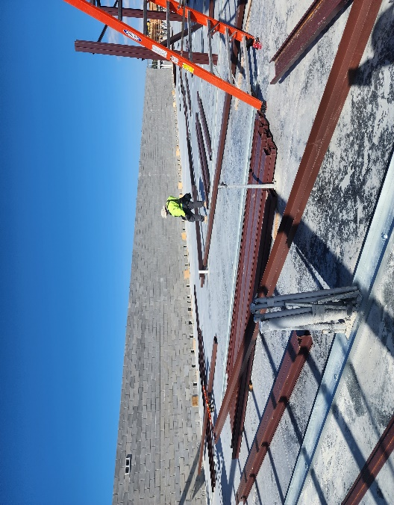
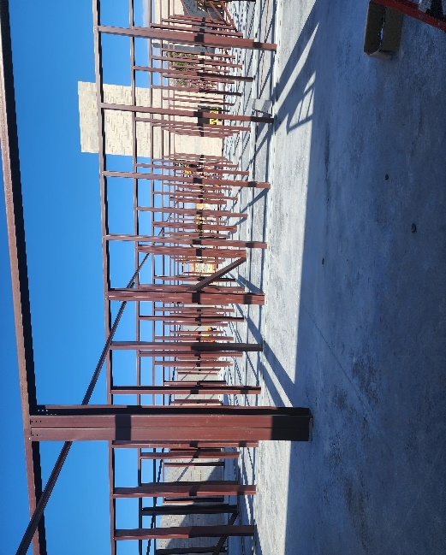
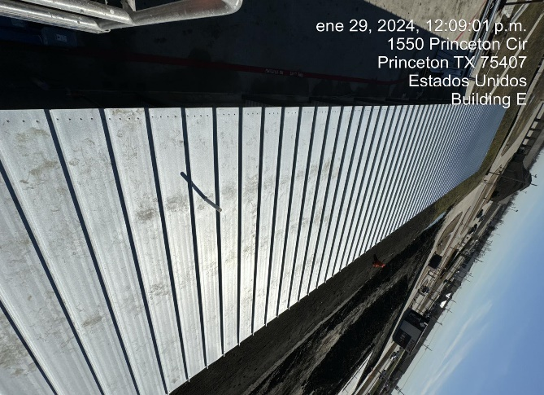
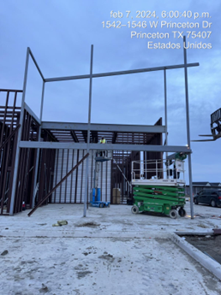
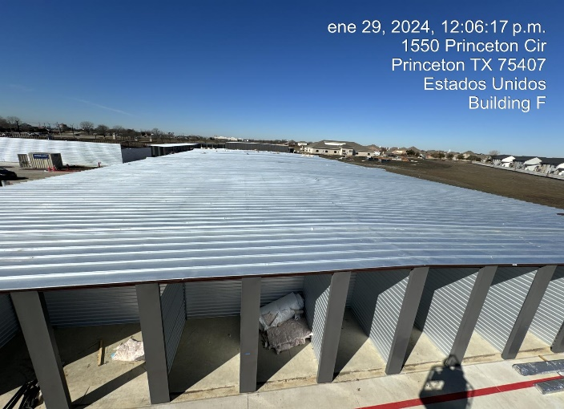
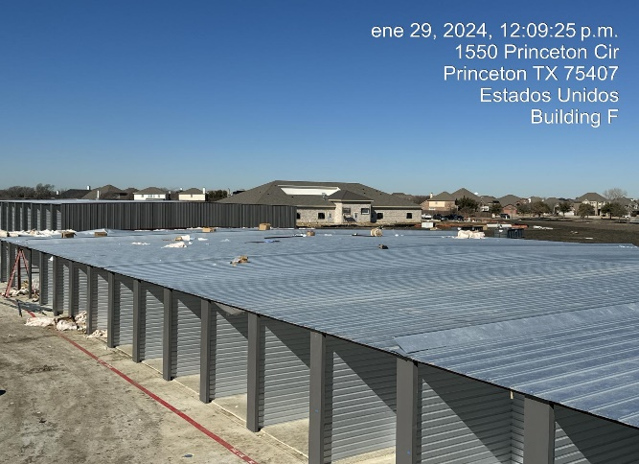
PHOTOS
Email: storageworldwide@gmail.com
Email: storageworldwide@gmail.com

Slide 6
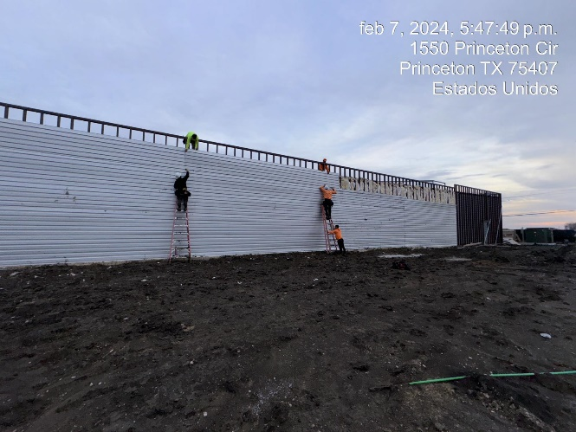
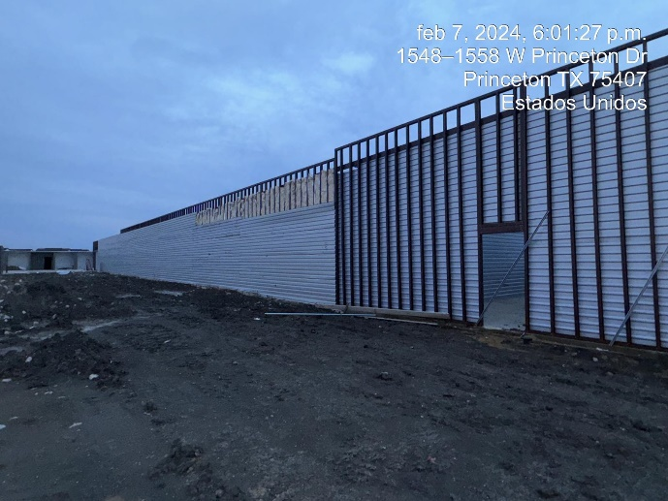
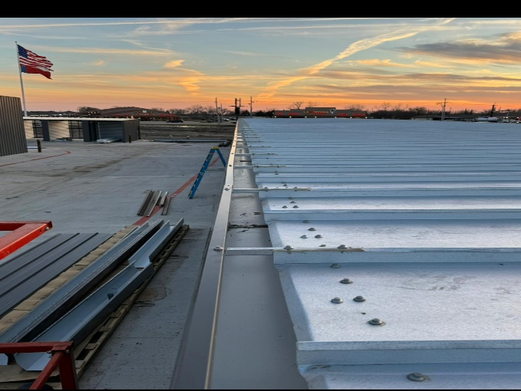
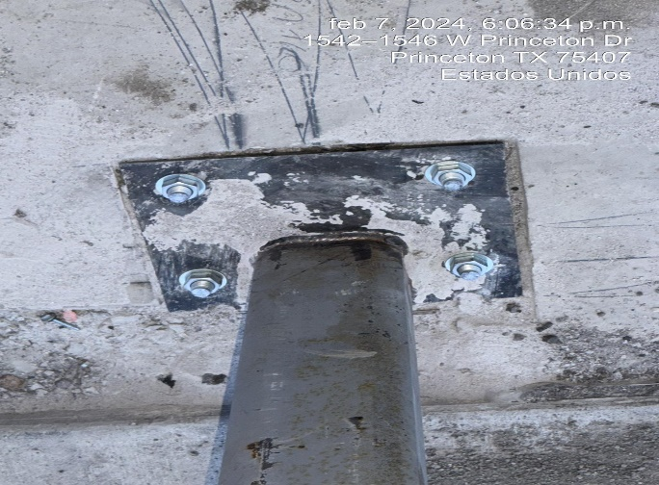
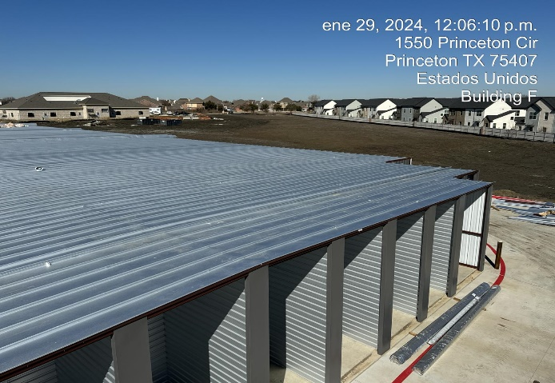
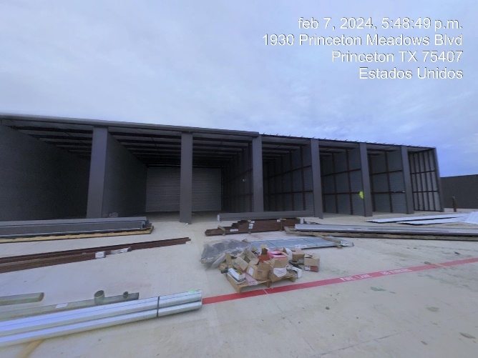
PHOTOS
Email: storageworldwide@gmail.com

Slide 7
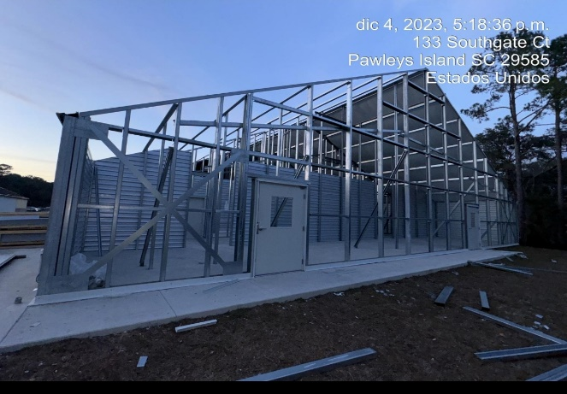
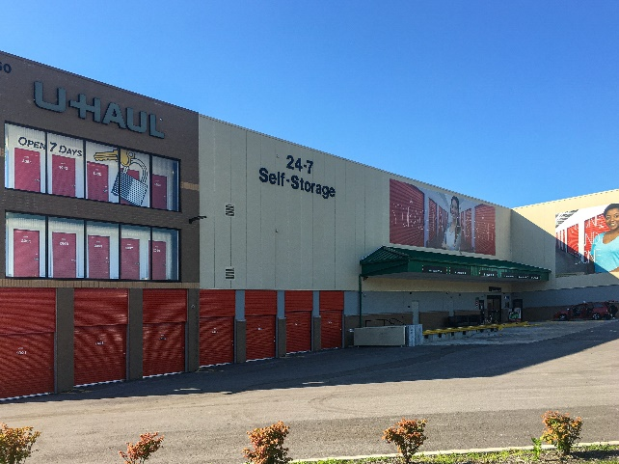
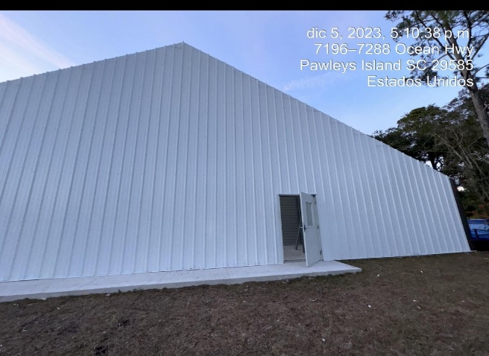
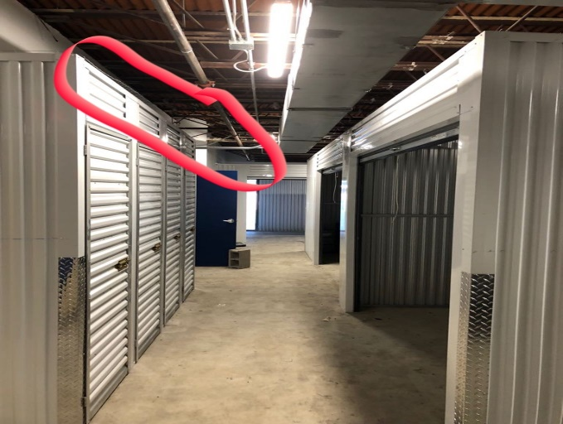
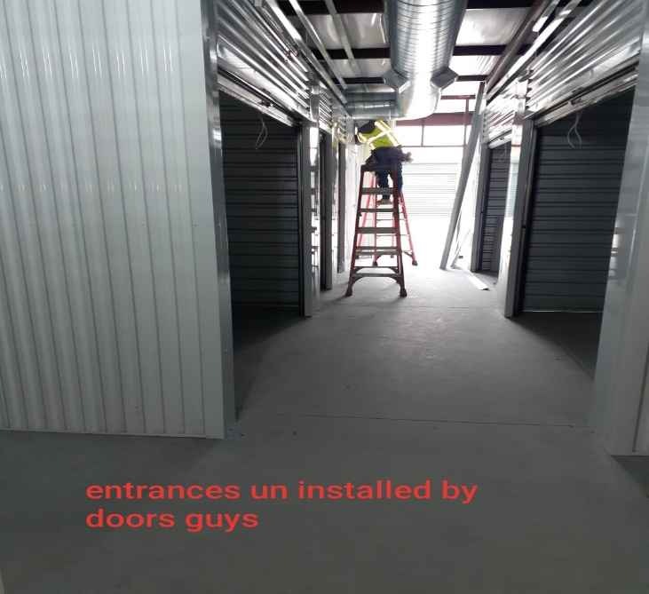
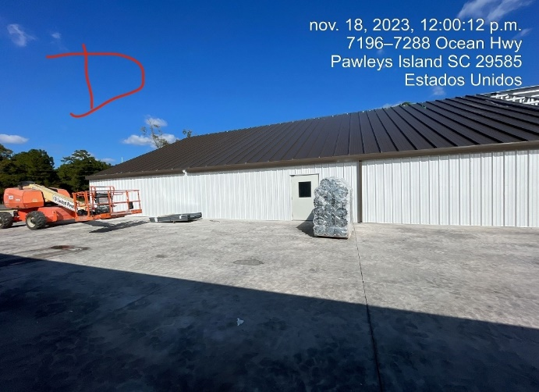
PHOTOS
Email: storageworldwide@gmail.com

Slide 8
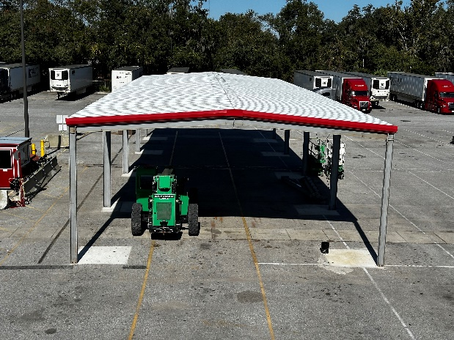
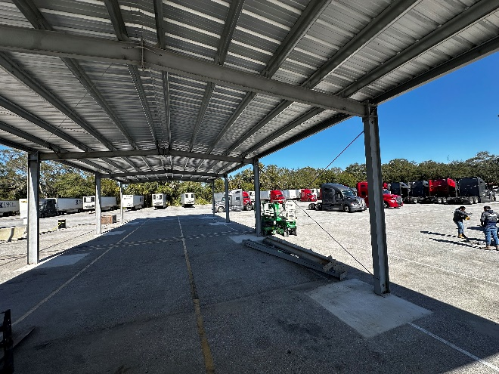
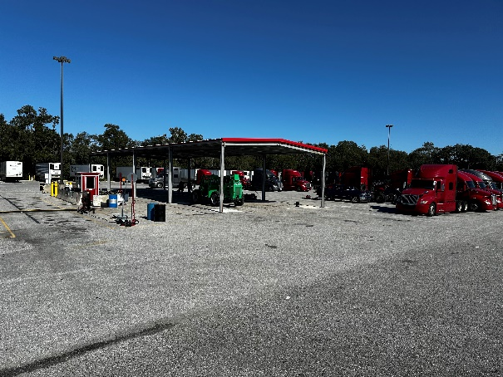
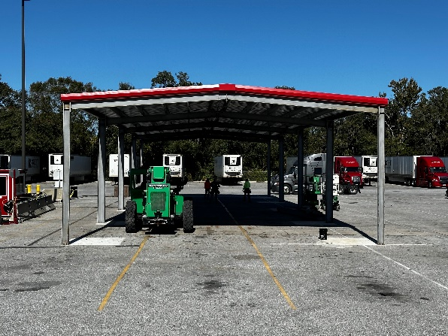
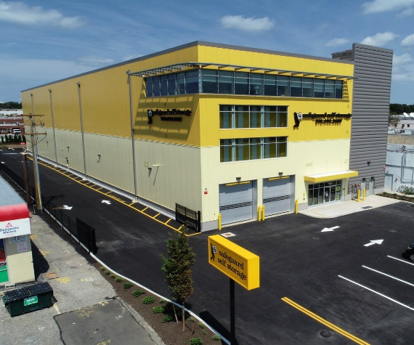
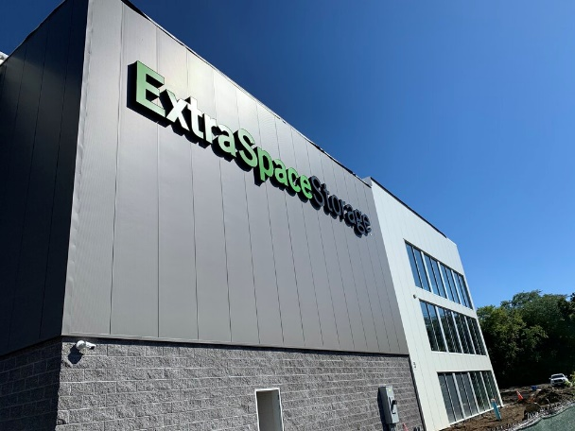
PHOTOS
Email: storageworldwide@gmail.com
PORFA ADICIONAR MAS

Slide 9
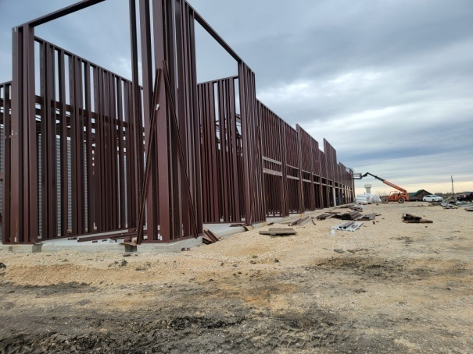
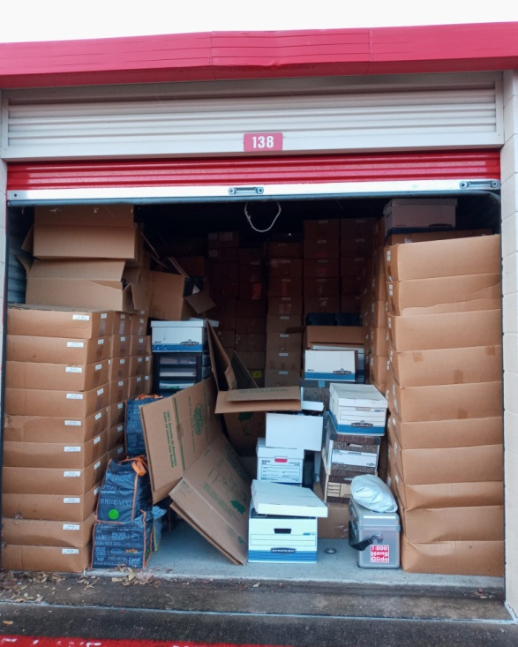
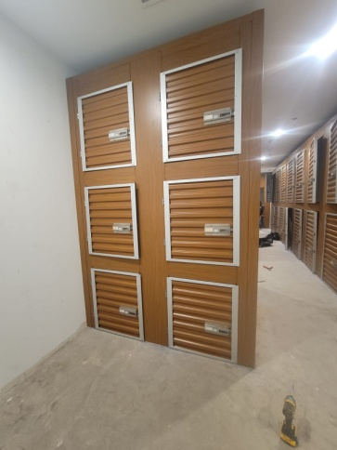
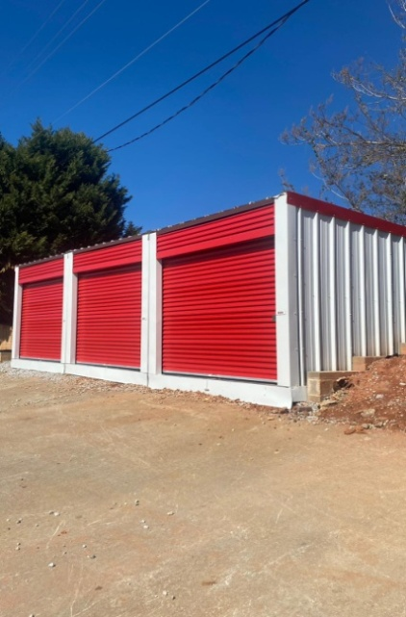
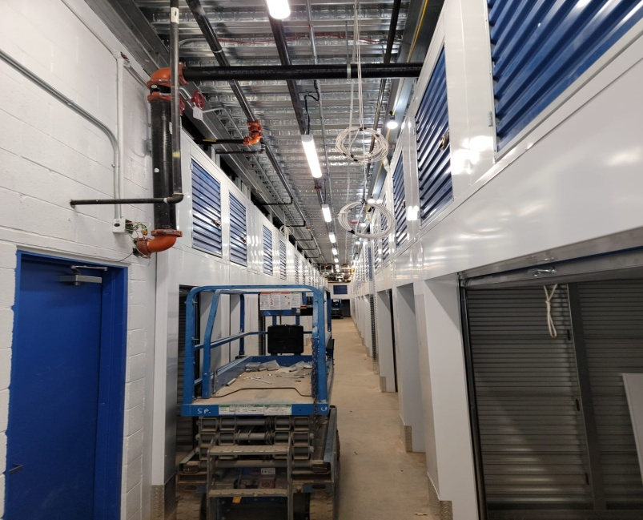
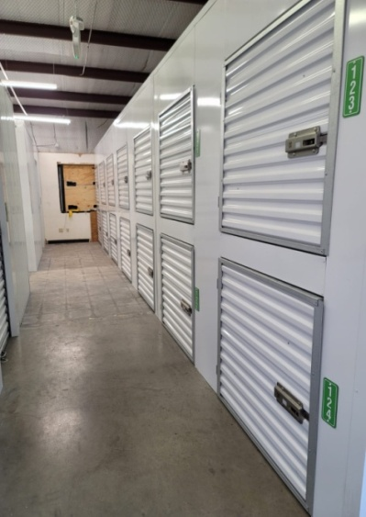
PHOTOS
FRAMING –COCOA -FL
REPLACEMENT DOORS
Email: storageworldwide@gmail.com
WINE LOCKERS-HOUSTON TX
MOBILE HOMES
GARDEN CITY-GA
LOCKERS – AUSTIN -TX
SKY LOCKERS-UNION CITY- NJ

